Slide 1
Data visualization
Stefan Hartmann
HHU Düsseldorf

Slide 2
Visualizing (morphological) data
Stefan Hartmann
HHU Düsseldorf

Slide 3
Plan for today
Introduction
Basics of data visualization
Data wrangling in R
Break
Basics of ggplot2
A first example graph
Break
Case studies and hands-on exercises
Some (fairly random but perhaps useful) tips and tricks

Slide 4
Introduction

Slide 5

Introduction
Who am I? Who are you?
Notes:
What are you expecting from this class? What's your experience in R? If you don't know R, do you know other programming languages?

Slide 6
Principles of data visualization

Slide 7
Data visualization
Why visualize?
For yourself
Exploring your data
detecting outliers
checking assumptions of statistical tests or models (e.g. are the data normally distributed?)
etc.
For others
Showing your findings in a clear and efficient way
Graphs tend to be more reader-friendly than tables...
and much more reader-friendly than long inline lists!

Slide 8
Data visualization
Choosing the "right" plot
What kind of data are you dealing with?
What is your research question?

Slide 9
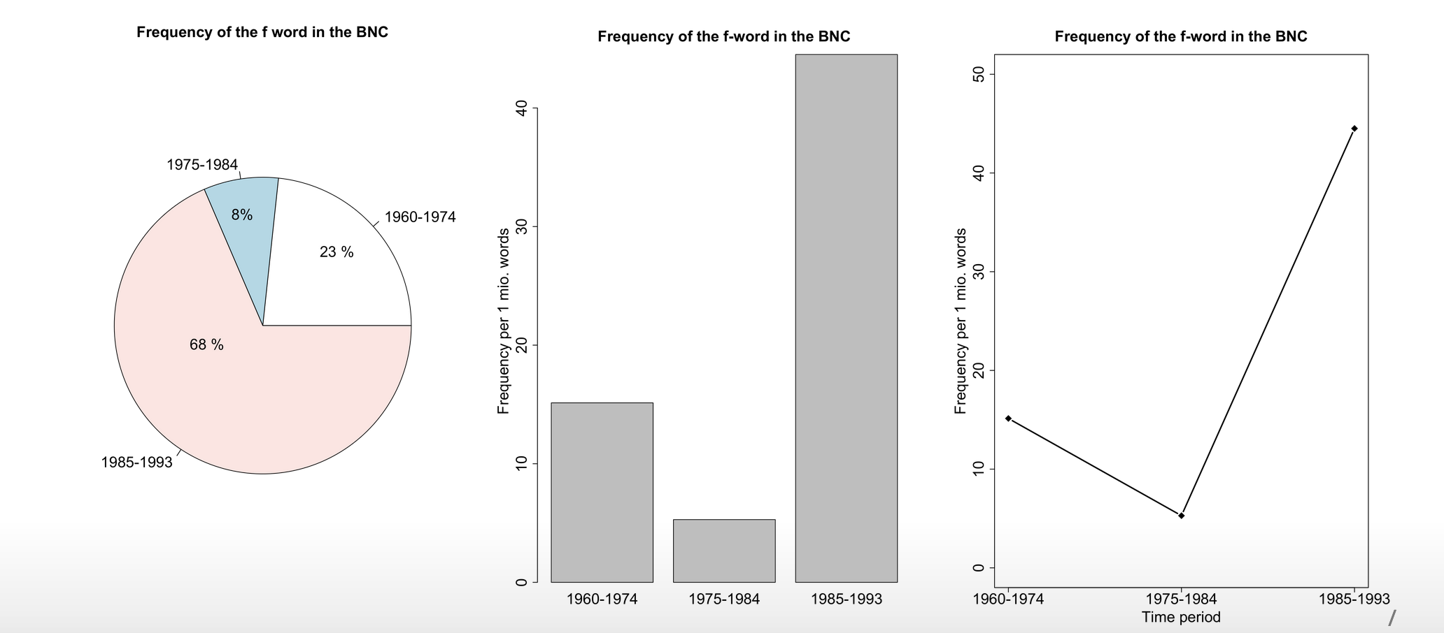
Data visualization
What kind of variable are we dealing with here?
Which visualization seems most appropriate to you?

Slide 10
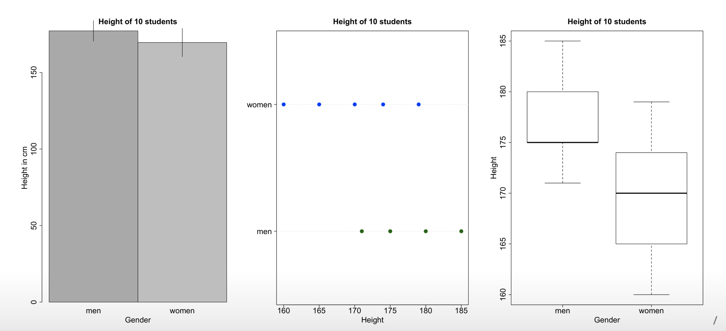
Data visualization
What kind of variable are we dealing with here?
Which visualization seems most appropriate to you?

Slide 11
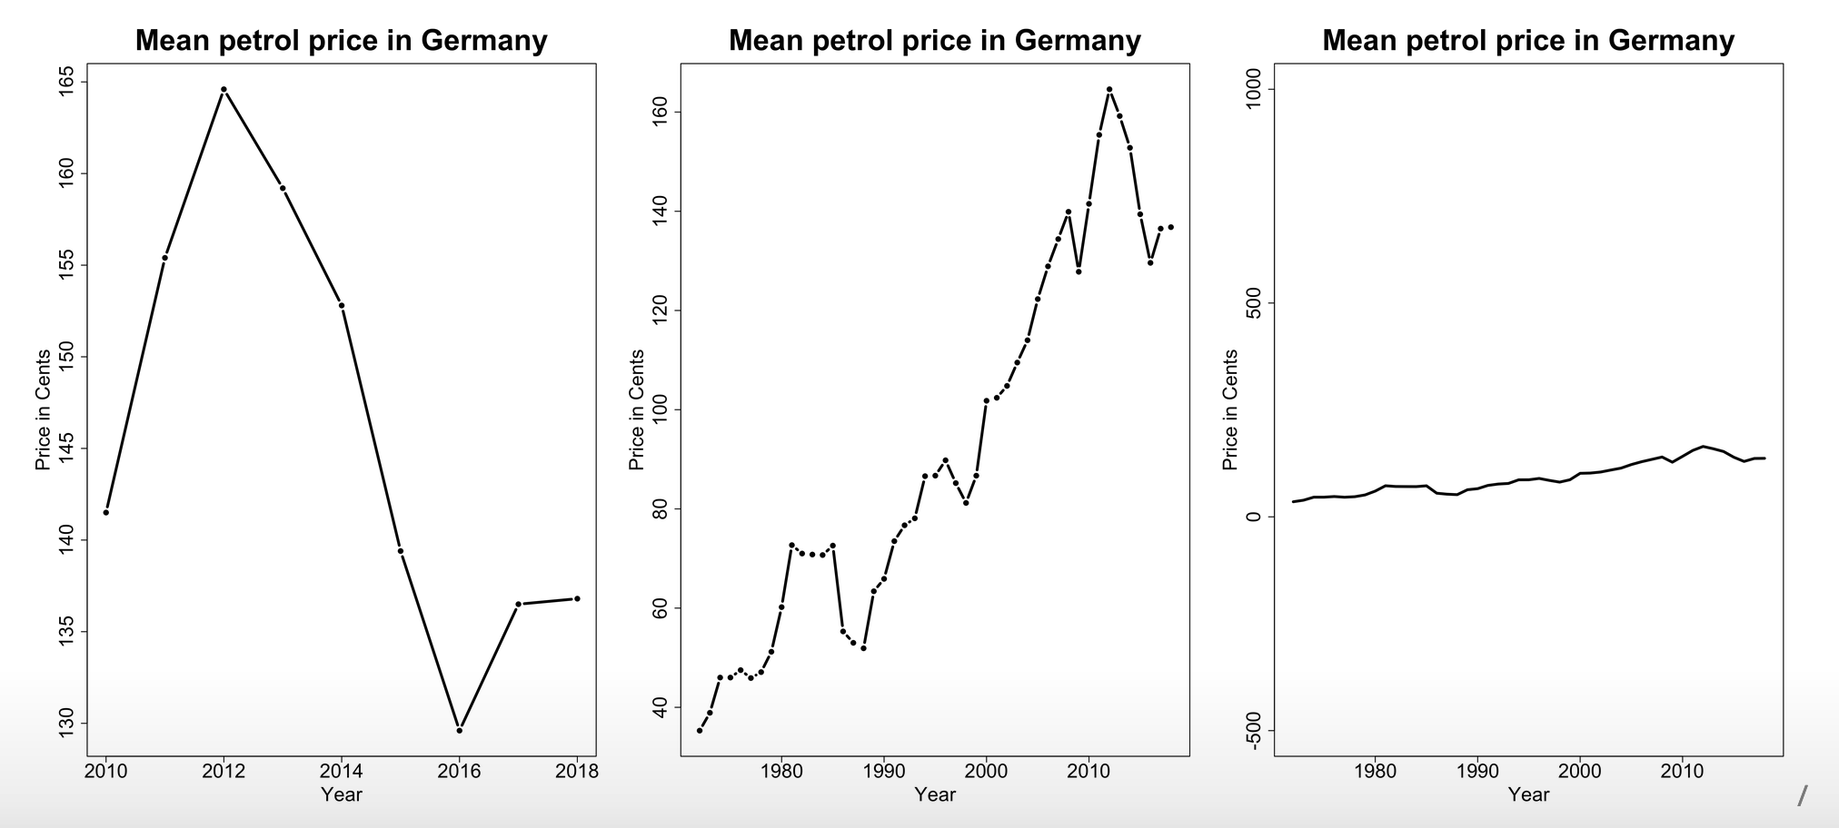
Data visualization
What kind of variable are we dealing with here?
Which visualization seems most appropriate to you?

Slide 12
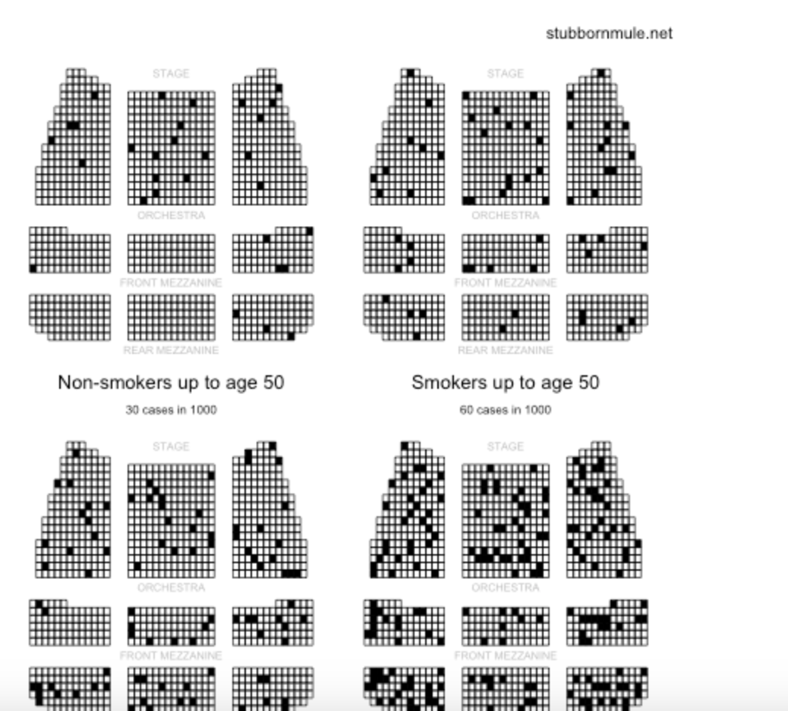
Alternative visualizations
from http://www.stubbornmule.net/2010/10/visualizing-smoking-risk/
"Risk Characterization Theatre" from Rifkin & Bouwer (2007)

Slide 13
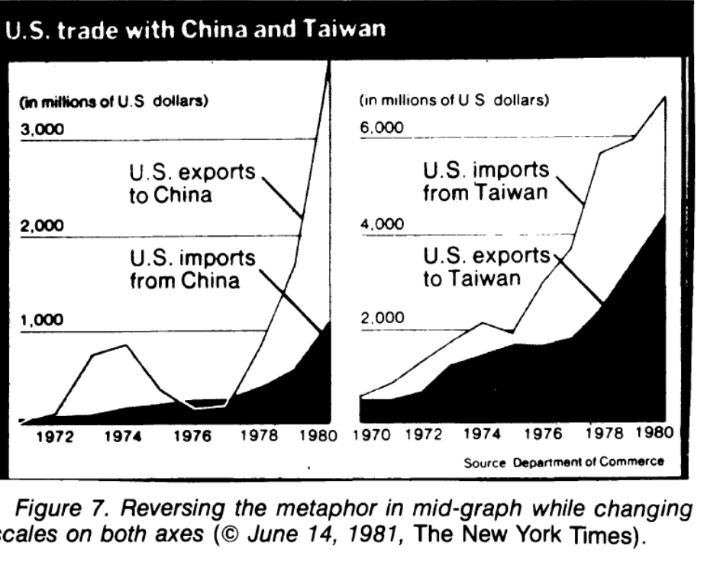
The plot as a metaphor
"The essence of a graphic display is that a set of numbers having both magnitudes and an order are represented by an appropriate visual metaphor - the magnitude and order of the metaphorical representation match the numbers." (Wainer 1984: 139)

Slide 14
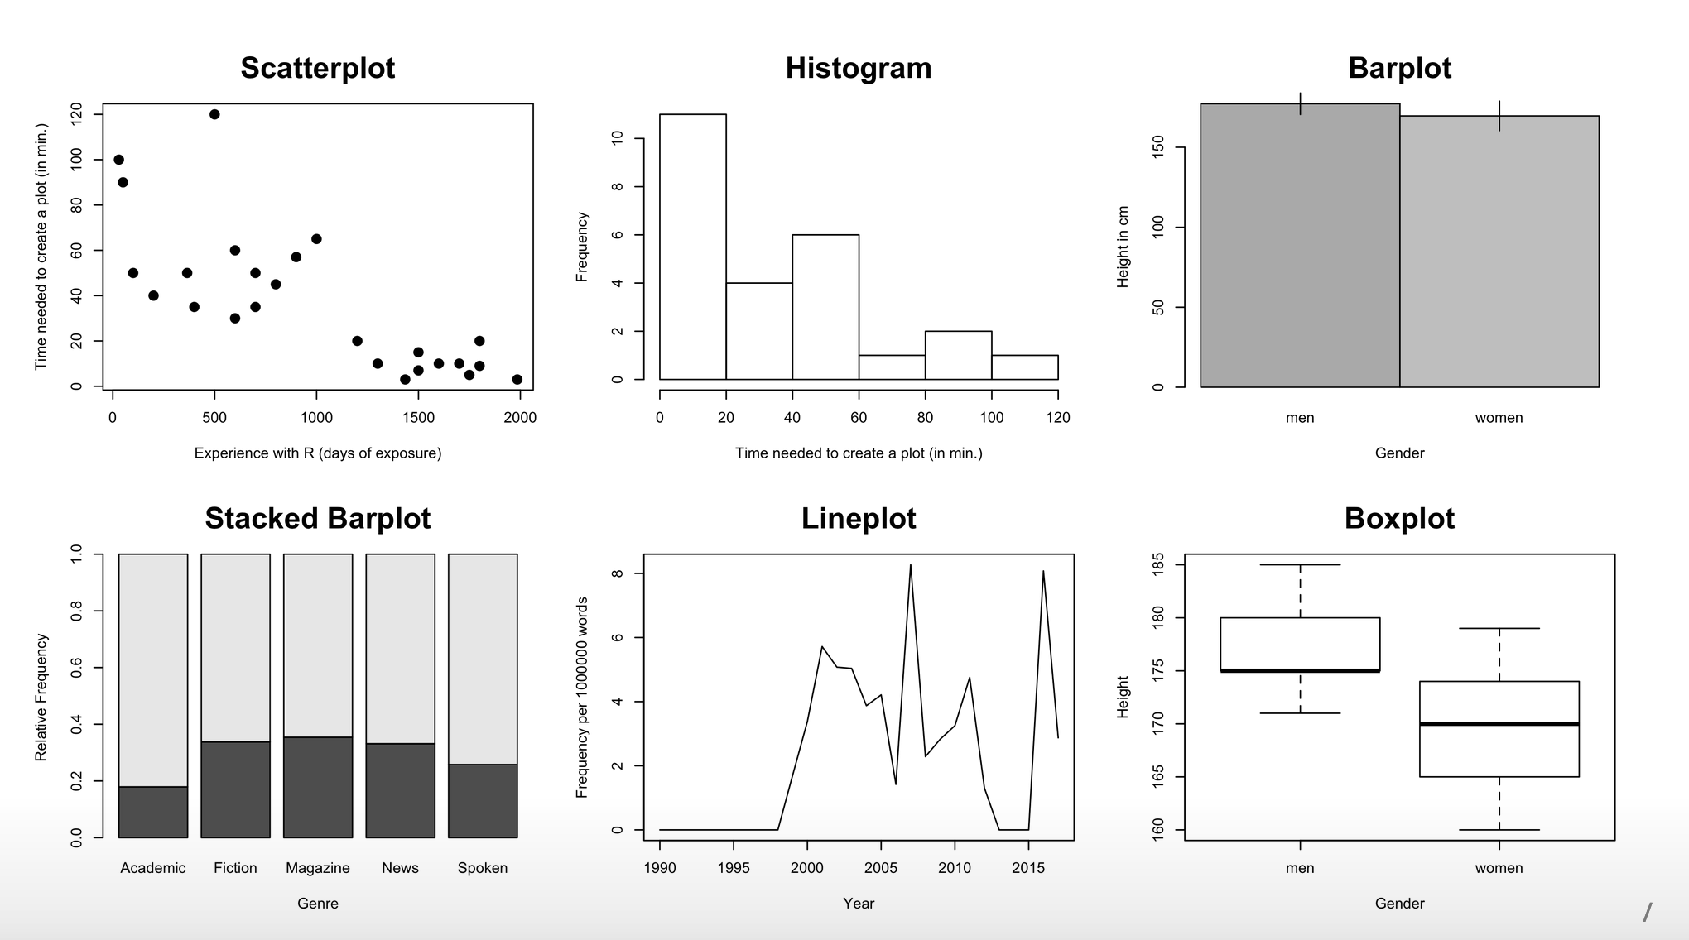
Plot types

Slide 15
Best practice for reporting & displaying data
Most importantly: Know your data!
When reporting percentages, also report the denominator (i.e. the size of your sample)
Example: "50% of academics are alcoholics" - it makes a difference whether your sample size is 2 or 2,000.
When reporting comparisons of absolute frequencies, double-check if your samples are comparable.
Example: "255 women agree that cats are adorable, but only 5 men." - it makes a difference whether your sample consists of 300 women and 300 men or of 300 women and 10 men.
When reporting means, also report standard deviations.

Slide 16
Best practices
Show the data
Avoid distorting the data
Keep "Ink-to-data ratio" as low as possible
Use meaningful x and y labels
Avoid overplotting (e.g. 3-dimensional plots when only 2 dimensions are displayed)

Slide 17
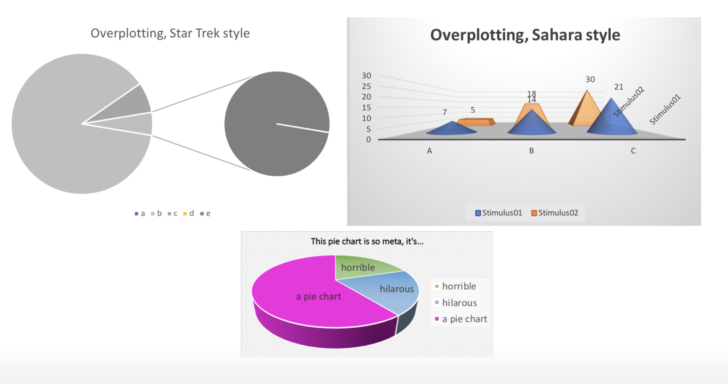
Beware of overplotting

Slide 18
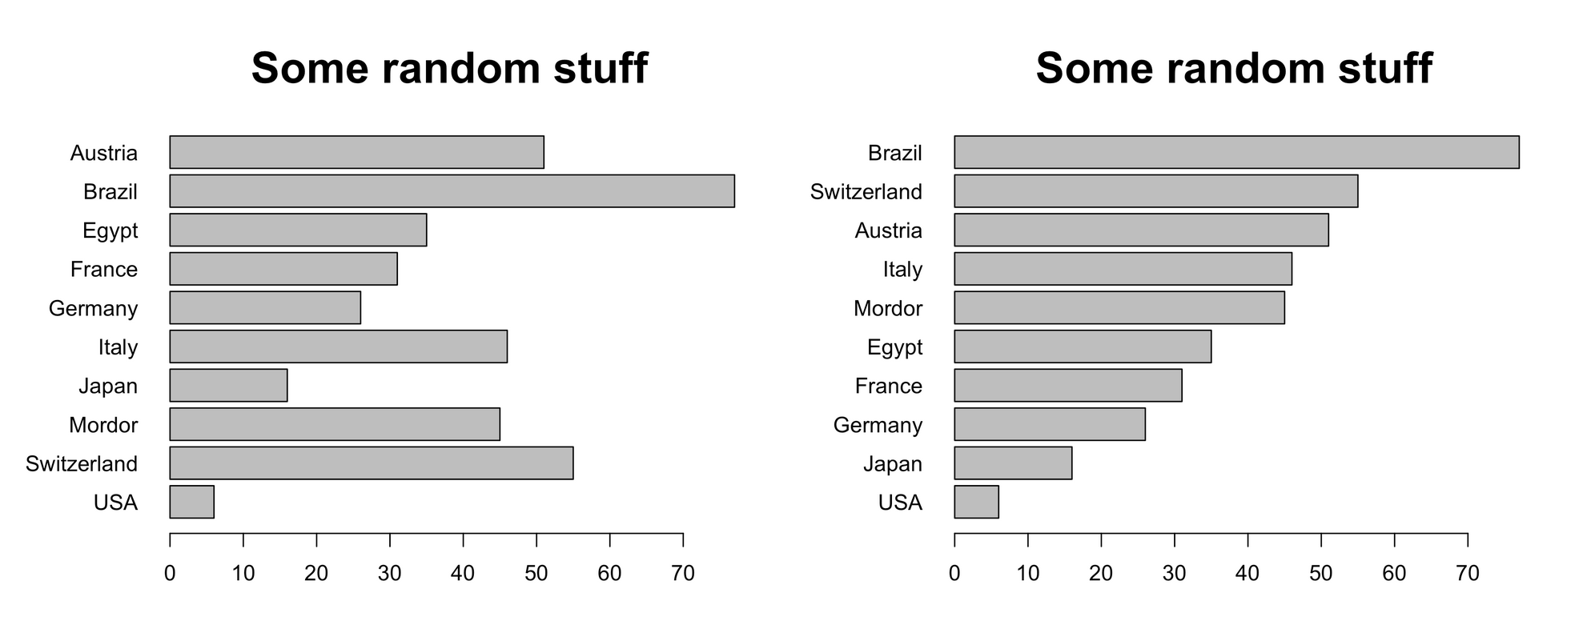
Further tips
If there is no natural order to your data, order them by value

Slide 19
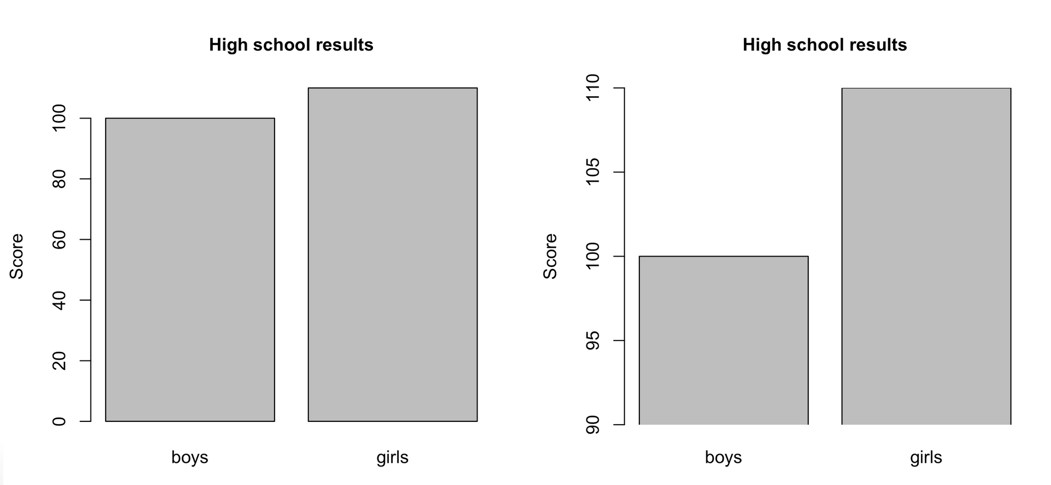
Further tips
Don't cut the y axis unless there are good conceptual reasons to do so.

Slide 20
Basics of R

Slide 21


R and RStudio
programming language
Integrated Developing Environment

Slide 22
Basics of R and RStudio
R: https://cran.r-project.org/
RStudio: https://posit.co/download/rstudio-desktop/

Slide 23
Basics of R
Things to know about R
R is, first and foremost, a programming language
RStudio is an Integrated Developer Environment (IDE) that provides a user-friendly "window" to R
There are two "dialects" of R:
base R,
the "tidyverse" syntax

Slide 24
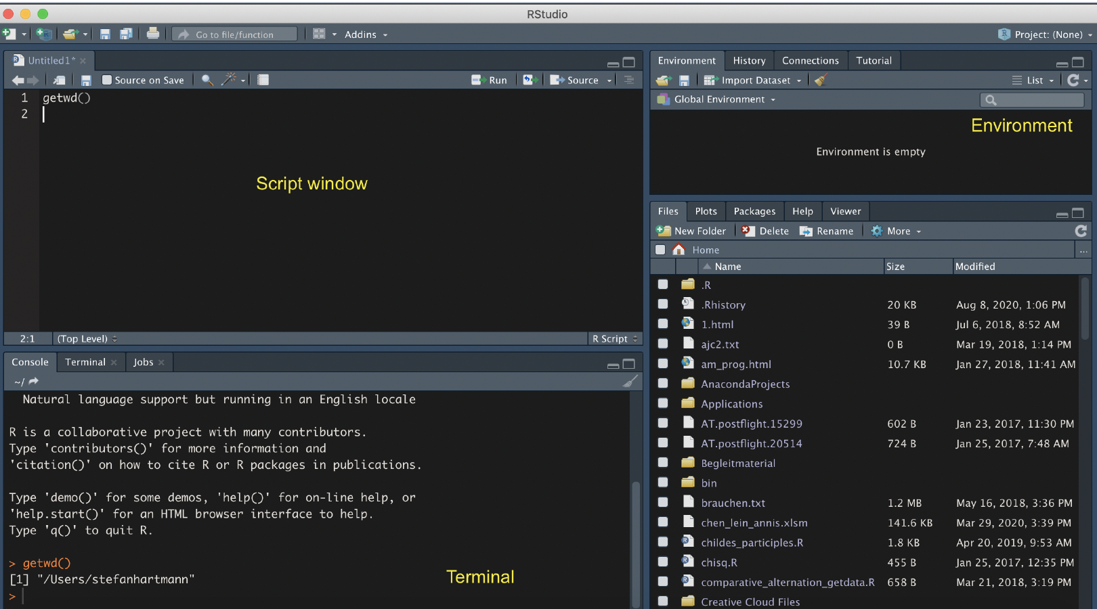
The RStudio Interface

Slide 25
First steps in R
R as a calculator
Please try:
2 + 2
sqrt(25)
5*6

Slide 26
Getting data into R
Important preliminaries
Ground rule: R is "stupid".
Unlike Google or ChatGPT, R doesn't try to correct our errors.
Among other things, this means that...
it is case sensitive
in some contexts, it makes a difference if you use scarequotes or not
When it has assigned a data type to an object, it will stick to it: if it thinks that "26" is a set of strings (characters) and not a number, then it won't do any calculations with it, unless you coerce it to treat it as a number using a command like as.numeric().
See https://www.burns-stat.com/documents/books/the-r-inferno/ for entertaining examples of R users' common errors.

Slide 27
Data wrangling in R

Slide 28

Data
Data available at https://tinyurl.com/evalmogithub
Notes:
Some files are rather big, so you might have to increase post buffer size first:
git config --global http.postBuffer 157286400

Slide 29
Types of data
Types of data in R
character: "a", "swc"
double: 2, 15.5
integer: 2L (the L tells R R to store this as an integer)
logical: TRUE, FALSE
complex: 1+4i (complex numbers with real and imaginary parts)
Notes:
Imagenary numbers: e.g. for square roots of negative numbers: Square roots of negative real numbers do not exist in the real numbers. They do exist in the complex numbers, using the imaginary unit 𝑖. For our purposes, we don't have to bother with imaginary numbers.
An integer can only take whole number values and requires an L to be added after the number to tell R you want the number stored as an integer.
Double-precision floating-point format (sometimes called FP64 or float64) is a floating-point number format, usually occupying 64 bits in computer memory;
Single-precision floating-point format (sometimes called FP32 or float32) is a computer number format, usually occupying 32 bits in computer memory; it represents a wide dynamic range of numeric values by using a floating radix point. Not supported by base R, but known to users of other programming languages under the name "float".

Slide 30

Base R and Tidyverse
What is the Tidyverse?
family of packages developed by RStudio/Posit
implement an own "dialect" of R
still fully compatible with base R, but adding more syntax possibilities

Slide 31
Base R and Tidyverse
Pros and cons of the Tidyverse
Pro:
syntax is arguably more intuitive and cleaner once you get used to it (especially "piping"!)
offers really neet functions for data wrangling
ggplot2 offers great possibilities for visualization
it is very widely used and many replies in forums rely on it
Cons:
it is under very active development, some functions become deprecated or change their names → problems for reproducibility
can be a bit patronizing (although this can sometimes be a good thing)
some things are ridiculously counterintuitive

Slide 32
Data wrangling and preprocessing
Steps
Structuring
Cleaning
Validating
Handling missing data (→ imputation)
Merging data from different sources
Transforming variables (can also be seen as already part of the statictical analysis*)
*In fact, all these steps are, strictly speaking, part of the analysis!
Notes:
imputation: replacement values for missing data
Transforming variables kind of already is part of the statistical analysis, though

Slide 33
Dealing with dataframes
Reading in dataframes
Commands for reading in spreadsheets:
CSV: readr::read_csv()
TSV etc.: readr::read_delim(delim="\t", ...)
Excel: readxl::read_xlsx()
plain text: readr::read_lines()
large files: vroom::vroom or datatable::data.table()
the stuff before :: refers to the packages to which these functions belong and can be omitted if you have loaded the packages via library() or require(). readr() is part of the tidyverse and is automatically loaded when you run library(tidyverse)

Slide 34
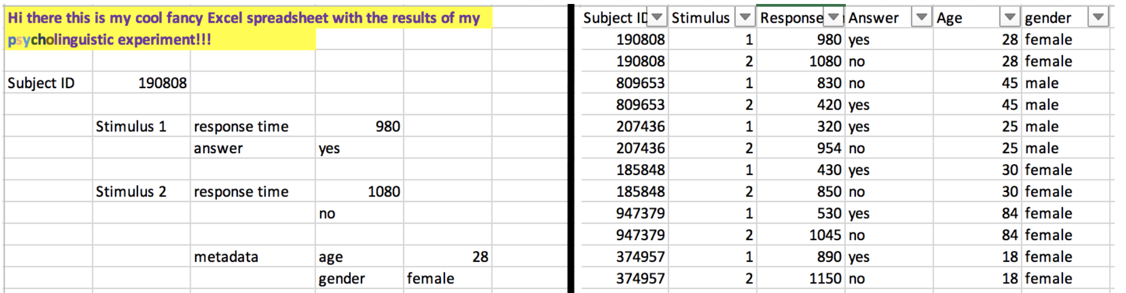
Data wrangling
"Tidy data"
Use "tidy data": One variable per column
One observation per row

Slide 35
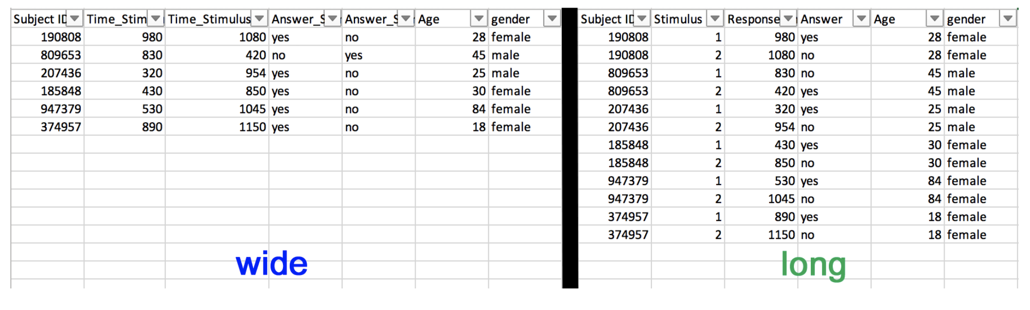
"Long" vs. "wide" format

Slide 36
"Long" vs. "wide" format
From long to wide format
If necessary, data can be converted from "long" to "wide" format using the pivot_wider() and pivot_longer() functions from the tidyverse family of packages.
(They may not be 100% intuitive but with a bit of trail and error they work really well!)

Slide 37
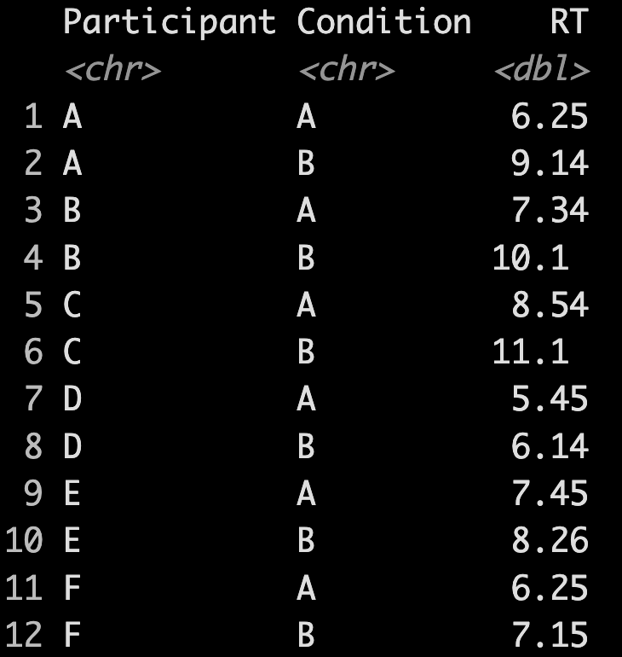
"Long" vs. "wide" format
Hands-on example...
Read the dataset fake_RT_data.xlsx using readxl::read_xlsx
Use the pivot_longer() command to transform the dataset in a longer format:

Slide 38
Dealing with dataframes
Merging multiple dataframes
In many cases we want to combine dataframes, e.g. because one dataframe contains metadata pertaining to the other dataframe
Example: We have one file with corpus data, with one column specifying the author, and one file with birth and death dates of each author crawled from the German National Library and/or Wikipedia
We can combine the dataframes using dplyr's join() commands.

Slide 39
Dealing with dataframes
Hands-on task
...

Slide 40
Basics of ggplot

Slide 41

ggplot
The syntax of ggplot
A ggplot consists of three components
the data,
a set of aesthetic mappings,
at least one layer (usually created with the geom function) describing how to render each observation.

Slide 42
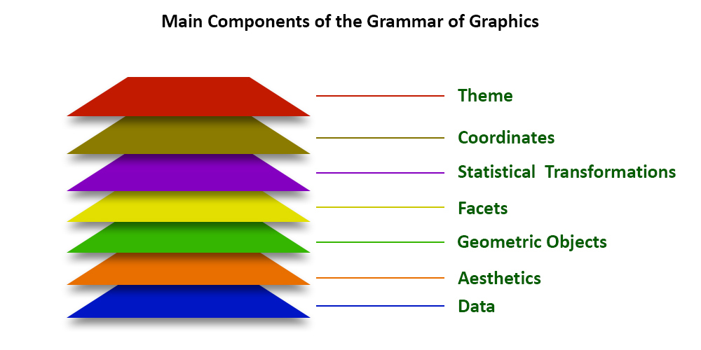

Slide 43
ggplot
Creating a ggplot
A ggplot is built layer by layer
We start out with the data and the aesthetic mappings
Basic syntax:
p <- ggplot(data, aes(x = ..., y = ..., group = ...))
We specify the geometric objects to plot, e.g.
p <- p + geom_line() # lineplot
Optional: We customize the scales (position, color, size) and/or change the theme of the plot
p <- p + scale_color_grey() + theme_minimal()

Slide 44
ggplot
A basic ggplot
First step: generating fake data
Try to create a dataframe with two columns x and y, with x containing the numbers from 1 to 100 and y 100 normally-distributed random numbers (rnorm(100)).
Second step: visualizing the data
Plot x against y using base R first and then using ggplot.
Third step: customizing the plot
Play around with different scale configurations and themes.

Slide 45
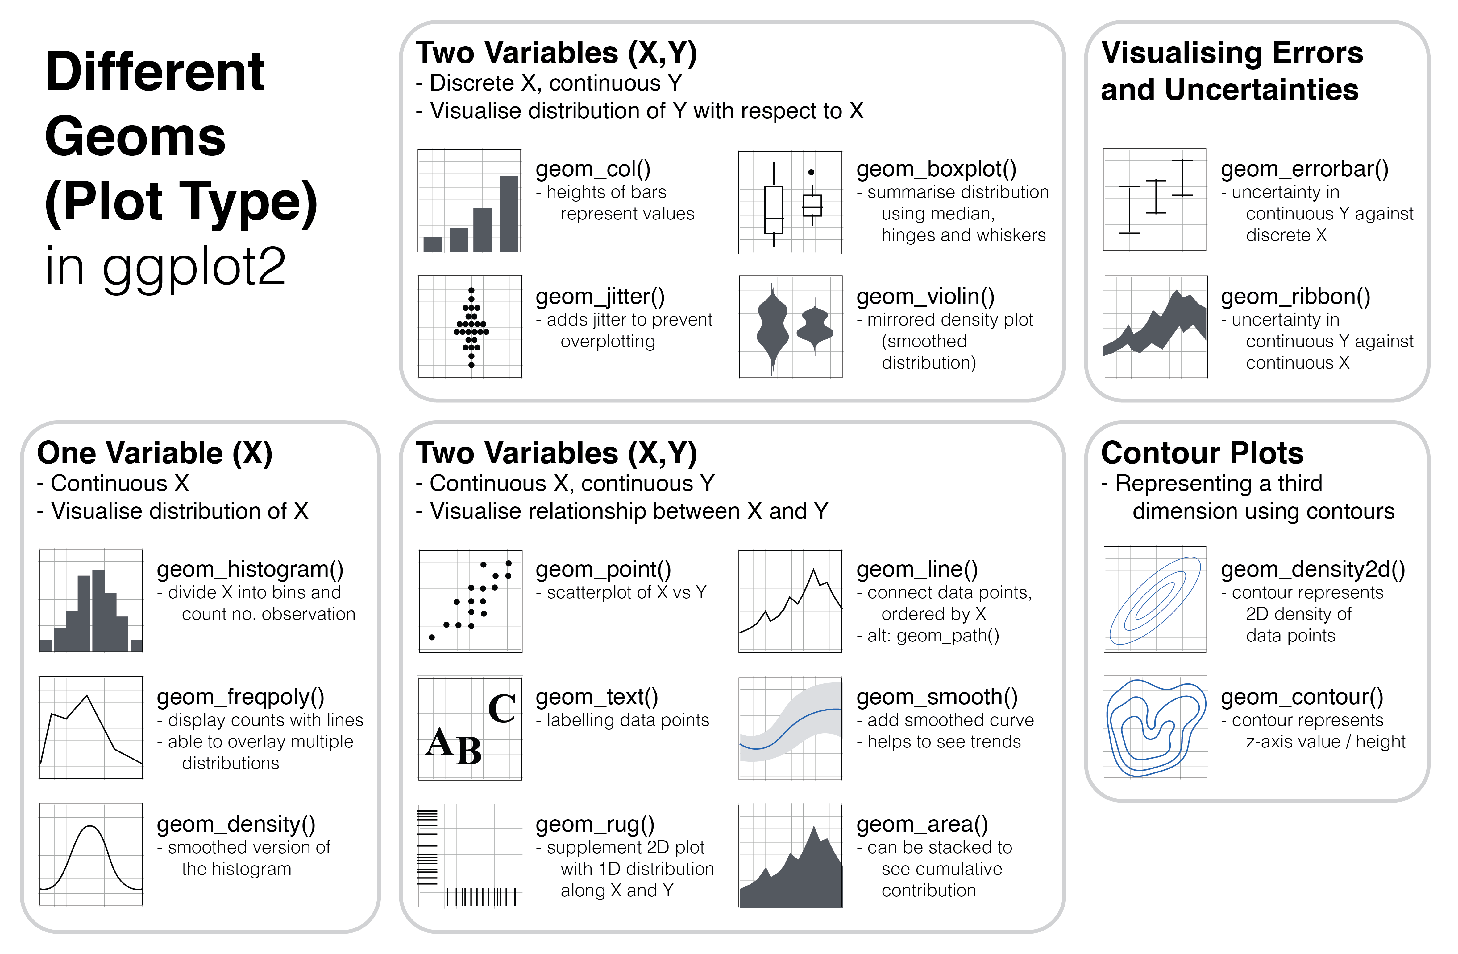
What kinds of geoms exist?

Slide 46
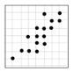
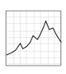
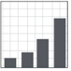
Plot types
Which plot types for which purpose?
Scatterplots
show / explore correlations between two variables
metric data on both the x- and the y-axis
Line plots
Lineplots are useful for showing e.g. change over time
Count variable on y-axis, (at least) ordinal variable on x-axis
Barplots
useful to show counts of categorical variables (e.g. number of men vs. number of women in parliament)...
summary statistics (usually: means) of metric variables across different categories (e.g. mean height of humans vs. Klingons)

Slide 47
More plot types
Beeswarm plots
Packages beeswarm and ggbeeswarm
can be combined with violin or boxplots

Slide 48
Interactive plots
e.g. (gg)plotly packge
and shinyplots (shinyplots.io)

Slide 49
Some tips and tricks
Cheat sheets
Code snippets
Google/Stackoverflow is your friend ☺

Slide 50
Hands-on examples...

Slide 51
Task 1a
ung-nominalizations
The file ungbaby.csv contains a concordance of ung-nominalizations from a subset of the German Text Archive
The file dtababy_with_author_data.csv contains metadata about the authors.
Find out how the two files can be merged in such a way that the metadata about author and texttype are added to each row, based on the document ID.

Slide 52
Task 1b
ung-nominalizations – Morphological productivity
Use the resulting dataframe to calculate the potential productivity (e.g. Baayen 2009) of the pattern for each text type and for each decade.
To do so,
add a decade column based on the existing column "Year" – replace the last digit by 5 using gsub() (hint: regular expression for the last character is .$);
use the tidyverse summarise() command.

Slide 53
Task 1c
ung-nominalizations – Visualizing productivity
Now visualize the productivity development. Select the plot time that seems most appropriate to you and plot one panel for each of the three text types.

Slide 54
Task 2
-ish in the BNC
Load the dataset ish_BNC.csv.gz
Plot the development of the pattern's type-token ratio and potential productivity over time.

